Slide 1

Project: Analyze NYSE Data
DA101.3
Analytics With Spreadsheets Part II
Daniel Cabral Villela
Notes:
‹#›

Slide 2
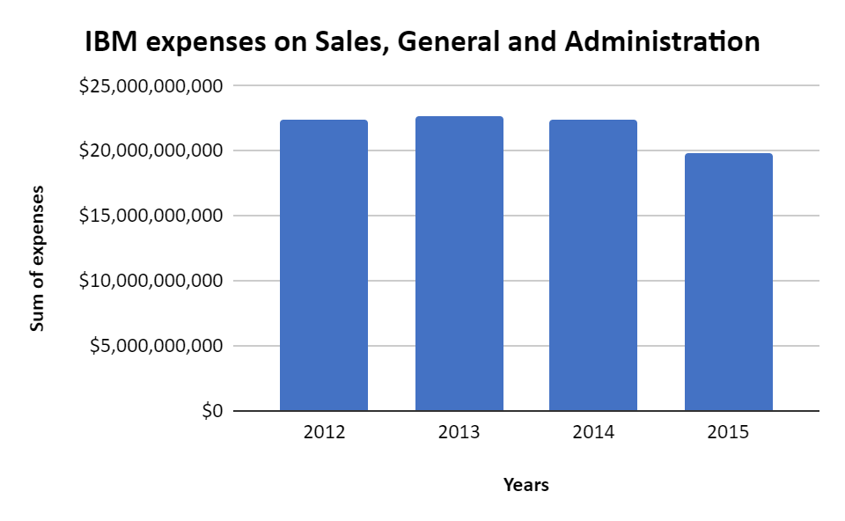
What is the average spending on Sales, General and Administration of IBM between 2012 and 2015?
Here is a bar chart of the Sales, General and Administration of IBM between 2012 and 2015. The interval 2012-2015 was chosen since it is the period which we have all the details of IBM and of all IT Consulting companies, for the purpose of comparison.
The IBM data results in a standard deviation of 1372577381. The range for Sales, General and Admin. of IBM ($2,881,000,000) is lower than in other IT Consulting companies ($4,210,756,000). Thus, the expenses in Sales, General and Admin are less volatile in IBM. From 2013 to 2014, the expenses decreased in 0.84%, and from 2014 to 2015, the expenses decreased in 11.99%.
The mean spending was $21,801,000,000 with a median of $22,413,500,000. This indicates a higher focus on reducing expenses, especially when compared to other IT Consulting companies, as seen on the following slide.
Link to Google Sheets: https://docs.google.com/spreadsheets/d/1n4DWEzfj4BJvT4ja5NBs9_NK60fd5-EHl0zvLyYzZIk/edit#gid=685990640

Slide 3
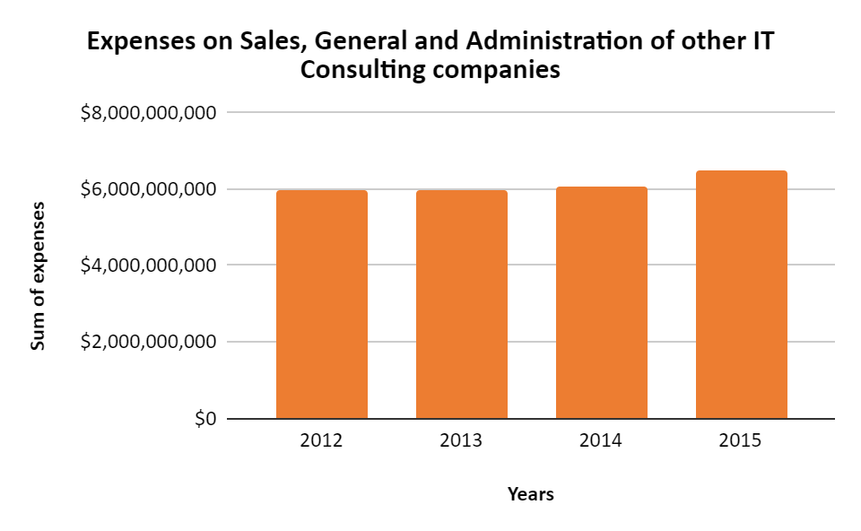
This graph of illustrates the Sales, General and Administration of other IT Consulting companies between 2012 and 2015. The data results in a standard deviation of 1594739953.
Throughout the years, the expenses decreased in 0.15% from 2012 to 2013. Then, they increased in 1.86% and, from 2014 to 2015, another increase of 7.23%.
This purpose of this bar chart is to contrast IBM’s situation with the other IT Consulting companies’, indicating a slight tendency of increase in expenses with Sales, General and Administration in 2016, which diverges from the reality observed for IBM.

Slide 4
IBM
Sales, General and Admin.
SUM | $87,204,000,000
MEAN | $21,801,000,000
MEDIAN | $22,413,500,000
MODE | #N/A
1st Quartile | $21,728,750,000
2nd Quartile | $22,413,500,000
3rd Quartile | $22,485,750,000
MINIMUM | $19,748,000,000
MAXIMUM | $22,629,000,000
RANGE | $2,881,000,000
STANDARD DEVIATION | 1372577381
Other IT Consulting companies
Sales, General and Admin.
SUM | $24,641,297,000
MEAN | $2,464,129,700
MEDIAN | $2,272,800,000
MODE | N/A
1st Quartile | $1,600,134,500
2nd Quartile | $2,272,800,000
3rd Quartile | $3,963,000,000
MINIMUM | $187,244,000
MAXIMUM | $4,398,000,000
RANGE | $4,210,756,000
STANDARD DEVIATION | 1594739953

